Slide 1
Dossier Preparation for Integrative Cases –
DEI and Thematic
Office of Academic Affairs
IUPUI

Slide 2
Welcome
Willie Miller
Faculty Advancement and Leadership Development Fellow
Keith Avin
Faculty Advancement and Leadership Development Fellow

Slide 3


Agenda
World’s Best Dossier
You
Defining the dossier
Conceptually
What it looks like online
Dossier Components
Candidate Statement
IUPUI CV/DMAI
Regular sections
Appendices
The eDossier System
Preparing files
Using it
Critical Documentation Issues
Co-authorship
Teaching Evaluations
Documenting scholarly impact
Across the
finish line

Slide 4
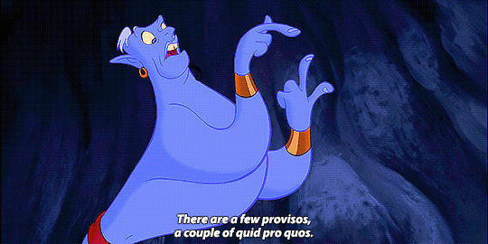
Exceptions
School of Medicine
Librarians, kind of
Research Faculty
© The Walt Disney Company
Notes:
For School of Med, the Dean does not allow balanced cases
Research faculty go up on research
Librarians still have a requirement for a performance-excellent case, but they have created a set of guideline that center DEI work as a part of performance

Slide 5
Defining the dossier

Slide 6
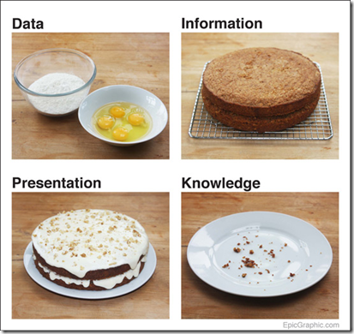
Defining the dossier
The dossier presents a clear case, with convincing evidence, for your promotion and / or tenure.
Your Dossier = Your CASE
List ←CV
Argument ←Candidate statement
Substantiation (documentation and details) ← main dossier
Raw materials ← appendices

Slide 7
Defining the dossier
The dossier presents a clear case, with convincing evidence, for your promotion and / or tenure.
What you’ve done
That you’re great!

Slide 8

The dossier, the eDossier
Your ”dossier” is the argument and evidence for your case.
Your “eDossier” is the format in which you submit it.
The system eDossier consists of MANY, MANY folders.
Don’t get lost! Don’t panic.

Slide 9
Dossier Components

Slide 10
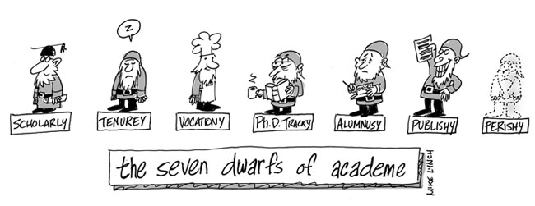
Candidate statement

Slide 11
Candidate statement: states your case
5-7 pages (single-spaced; regular margins)
  Additional details or explanations go in the rest of the dossier
Your present accomplishments and your future plans
The case is grounded in a sophisticated DEI or thematic philosophy
Accomplishments that are ‘direct’ impact, not or not just scholarly dissemination
Satisfying satisfactory in teaching, research, and service

Slide 12
DEI or Thematic Philosophy Statement
Balanced-Integrative Thematic Case
A DEI philosophy statement explains to the reader what particular aspect or angle of DEI(J) the candidate works on: refugee integration, educational disparities, research bias, etc.
For the ‘thematic’ case, the candidate should state their commitment/position on the theme. Examples: “community-engaged scholar” or “global education” or “translational science”
This is something that is not just “I do research.”

Slide 13
Template
Reference your department/school criteria
Focus, don’t dump
Edit for consistency with CV
Introduction: Who you are, what you are applying for, introduce integrative themes and sub-themes
Section 1: Sections on sub-themes; signature work products Independence, grant trajectory if applicable, impact
Future plans
3-4 pages
Sections 2-3: Addressing teaching, research, and service
At least satisfactory work in these areas—how you contribute to unit mission 1 page
Section 4: Summary
Distinctive individual contribution to unit/IUPUI/IU Plans for the future
1-3 paragraphs

Slide 14
Templates and Examples
Template
Example (entirely fake)
Annotated example (still fake)
Samples (real!)

Slide 15
Example: Lin Zheng, Clinical Professor
Candidate Statement
I seek promotion to the rank of Clinical Professor on a Balanced – Integrative Case based upon the theme of Global Learning…. My scholarly activities have advanced awareness and development of global learning for national and international audiences. ….My contributions have helped the IUPUI campus to fulfill its mission “to advance the State of Indiana and the intellectual growth of its citizens to the highest levels nationally and internationally through research and creative activity, teaching and learning, and civic engagement.” In addition, my achievements have supported Kelley’s mission of “transforming the lives of students, organizations, and society through management education, research, and service.”

Slide 16
Example: Lin Zheng, Clinical Professor
Candidate Statement
In this candidate statement, I detail my performance in teaching and service and discuss my future plans for continuous improvement. This statement is organized around four themes related to Global Learning: (1) Virtual Exchange; (2) Local Global Learning; (3) Study Abroad; and (4) Other Items. Furthermore, this statement addresses Scholarly Activities as well as Service and Teaching in Other Areas. A visual summary of areas discussed and my accomplishments in each area is provided in the Teaching folder.
Other sections: Scholarly Activities, Service and Teaching – Other Areas, Conclusion

Slide 17
IUPUI P&T CV

Slide 18
The IUPUI P&T CV
Is different from a disciplinary CV.
It contains additional information:
Course listings
Professional development attended
Unfunded grant submissions
It has a specific order of items.
Grants, presentations, and publications do not have to be binned for an integrative case.

Slide 19

The IUPUI P&T CV
For internal reviewers, places activities into total context
Is different from a disciplinary CV.
It contains additional information:
Course listings
Professional development attended
Unfunded grant submissions
It has a specific order of items.
Grants, presentations, and publications do not have to be binned for an integrative case.

Slide 20

The IUPUI P&T CV
Is different from a disciplinary CV.
It contains additional information:
Course listings
Professional development attended
Unfunded grant submissions
It has a specific order of items.
Grants, presentations, and publications do not have to be binned for an integrative case.
Campus committee has 125- 150 cases to read

Slide 21
The IUPUI P&T CV
Is different from a disciplinary CV.
It contains additional information:
Course listings
Professional development attended
Unfunded grant submissions
It has a specific order of items.
Grants, presentations, and publications do not have to be binned for an integrative case.
Candidate demonstrates how teaching, research, and service are integrated through a theme.

Slide 22
DMAI (Watermark Faculty Insight)
Provides you with a complete template
If you have been diligent in populating it, DMAI will output the entire properly formatted CV.
Delete the cover page.
Delete the explanation right before Publications. Delete any irrelevant section.
Do not move things around.
Things are sorted into the right areas because you have labelled them as to area.

Slide 23
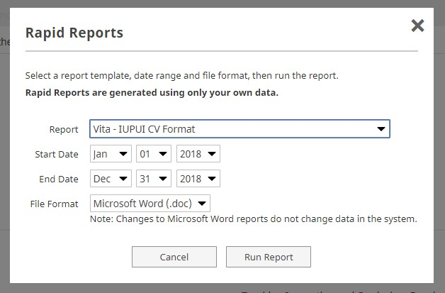
DMAI and P&T CVs
Rapid Reports function
  Vita
  Vita – IUPUI CV Format
Entries must have areas and
dates in order to be included
Edit the course listings to omit zero-enrollment sections
Don’t forget to
change the date!
Courses:
do not add student evaluation scores

Slide 24
Autopopulated items (by IU)
You:
Research:
Grants Presentations Mentoring Service
Education Appointments (jobs) Licensures Memberships Honors/awards
Professional development
Service
University Professional Patient Grants Presentations Mentoring
Teaching
All courses since 2012 Administration Grants
Presentations Mentoring Service
Publications:
Teaching Research Service

Slide 25
Importable items (consult with librarian)
You:
Research:
Grants Presentations Mentoring Service
Education Appointments (jobs) Licensures Memberships Honors/awards
Professional development
Service
University Professional Patient Grants Presentations Mentoring
Teaching
All courses since 2012 Administration Grants
Presentations Mentoring Service
May have been ‘binned’ for annual review
Publications:
Teaching Research Service

Slide 26
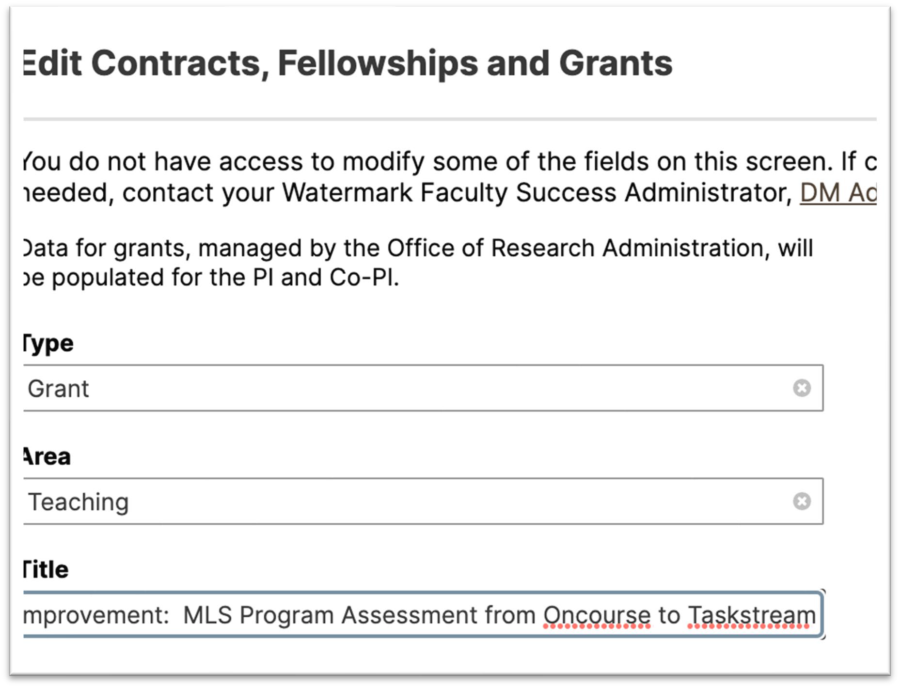


Indicate ‘area’

Slide 27
Annotate the CV? Markers?
Some faculty place small annotations within the CV.
DO NOT neglect these issues in the rest of the dossier: the CV does not substitute for other areas.
Examples:
Publications: citations
Presentations: acceptance rate
Multi-author works: brief mentions of your role
Markers:
Student co-authors: generally indicated by a dagger
Your authorship: often indicated by bolding
In-rank: EITHER:
  Use an asterix *
  Grey out not-in-rank items: especially useful for cases for full.
DEI items: #

Slide 28
If you don’t want to use DMAI
We have ‘tabbed’ and ‘table’ formatted Word documents: Dossier Forms.
You will have to input lists of courses in the approved format: consider going to DMAI for that and pasting them in. DMAI is auto-loaded with all your courses since you came here or 2012, whichever is later.
The IUPUI P&T CV is instantly recognizable.
Campus reviewers will know if you are not following this outline.

Slide 29
The eDossier System

Slide 30
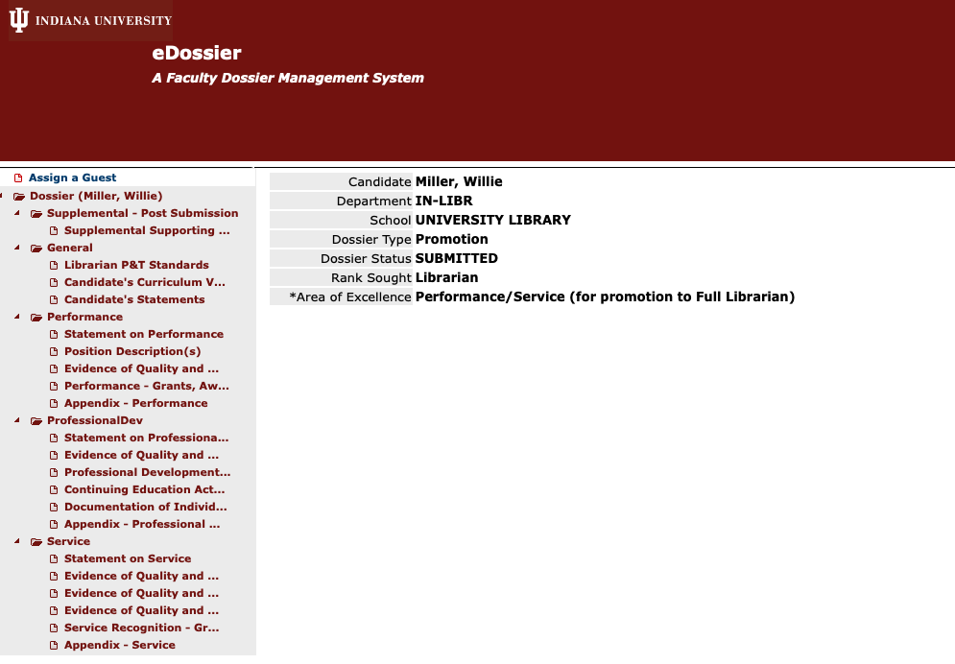
What e-dossier looks like to candidates

Slide 31
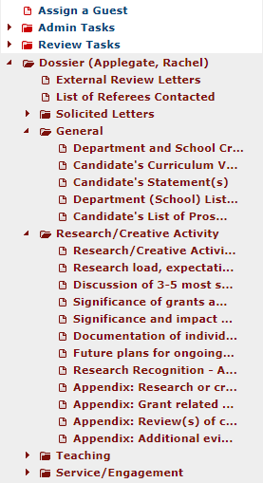
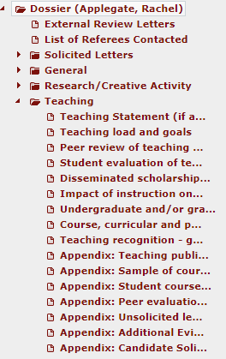
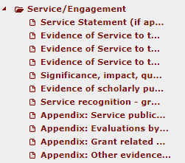


These appear in one long vertical list on the left side;
Open and close the various areas using the triangle

Slide 32
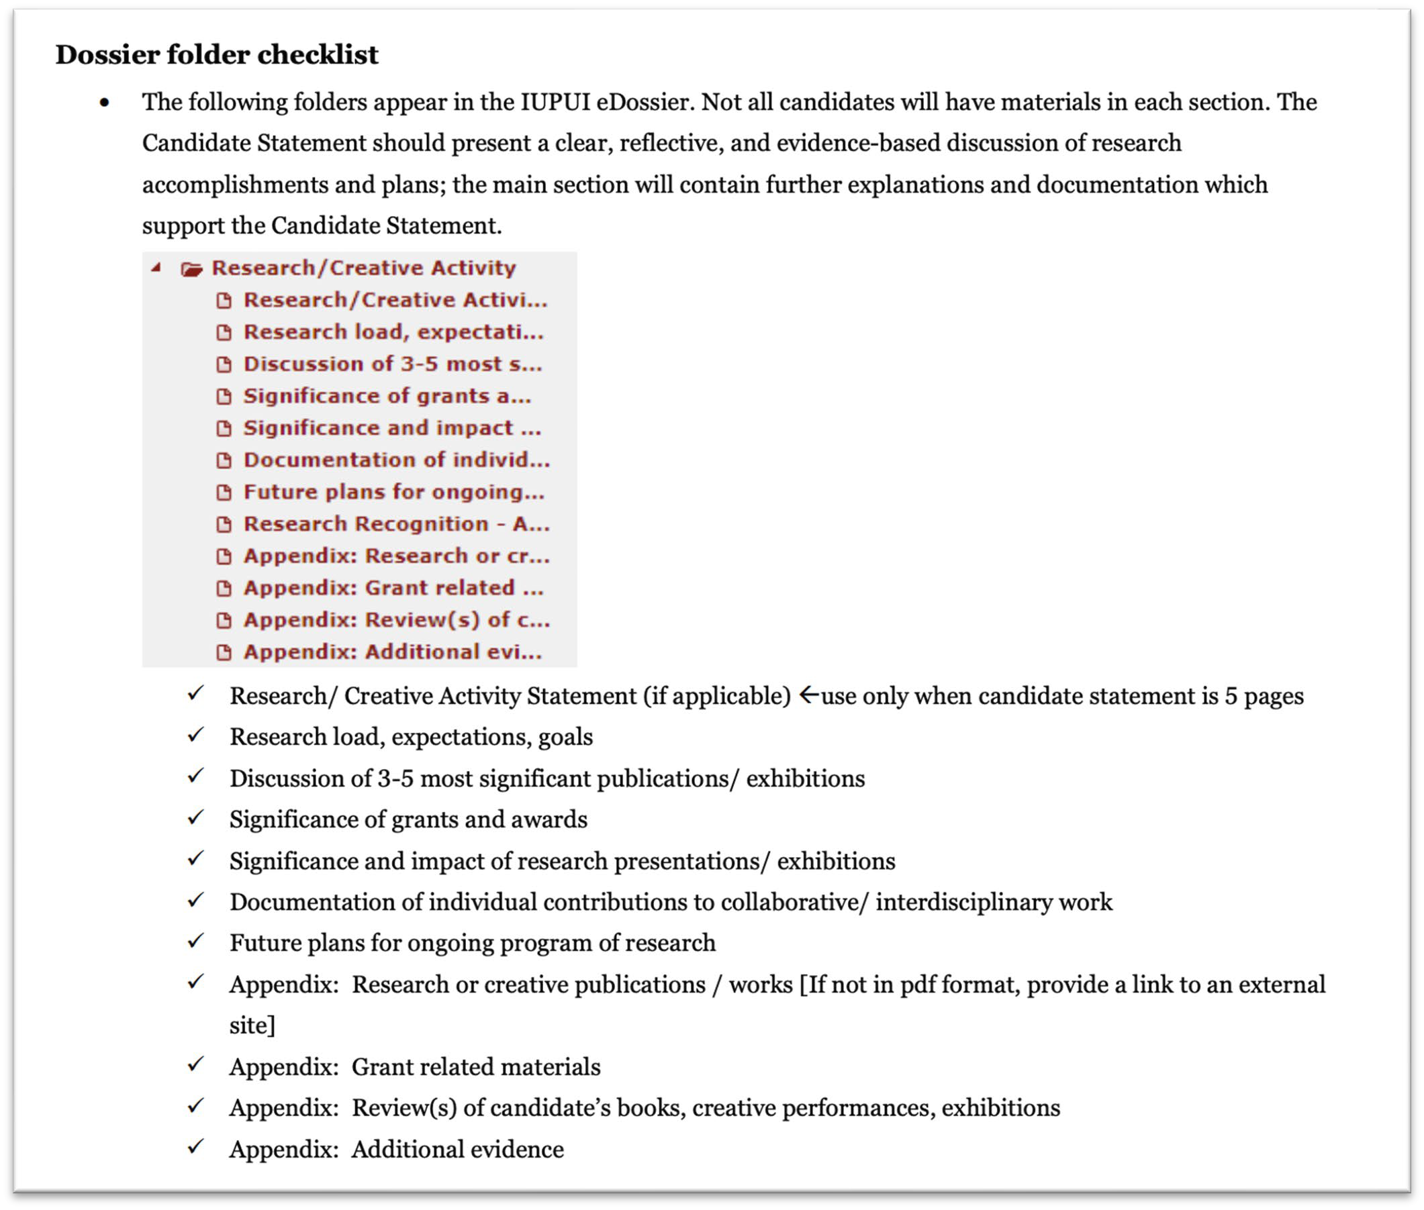
The P&T Guidelines list all the sections

Slide 33
Finalizing the dossier
Summer before review year
IUSM: earlier
eDossier NOT available until late summer
Decision:
Save everything into appropriate folders OR
You may save everything in EACH main section in ONE file
Use WORD format for eDossier files. (This is a new recommendation.)
Maximum of 50 pages (including candidate statement, 5 OR 7 pages; NOT including CV) for the regular folders
  This is a conceptual limit. Don’t make readers think you are ignoring the limit; don’t fret over half-pages.
ALERT! E-DOSSIER FREEZES ONCE YOU SUBMIT AND THE CHAIR CONCURS! NO CHANGES CAN BE MADE, ONLY ADDITIONS IN A SPECIAL FOLDER.

Slide 34

Why eDossier?
Secure storage
Per IU policy, decisions are made ONLY on materials IN the e-dossier.
Routing
Each level is separate and can only work once the previous level has finished = be prompt!
Primary (dept) committee
Committee votes and reports
Chair votes and reports
Unit (school) committee
Committee votes and reports
Dean vote and report
Candidates are notified at each stage by the responsible party.
Adjustments made for schools without departments, or core schools.

Slide 35
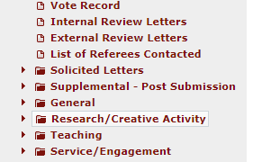
After submission
New material
Supplemental folder
Storage
Routing
Notifications

Slide 36
What does ‘new material’ mean?
General updates:
  Changes of status to items (e.g. publications accepted, grants received)
  Corrections: after a dossier is submitted, NO changes can be made; new or changed versions need to be uploaded to the Supplemental folder
  Consider how important these are. Use sparingly; label clearly
  Generally avoid narrative: present new evidence

Slide 37
If I have something amazing happen in my review year?
It was too late to get into my dossier.
SAVE IT for your promotion-to-full case!
Your promotion-to-full case is based on ‘work in rank’ i.e. work completed since your last promotion.
Anything that was not ready to go into THIS promotion is available for your NEXT promotion.
In other words, do NOT update your dossier with additional materials unless only with that new material would you be successful.

Slide 38
Regular Sections & Appendices

Slide 39
Recap: 3 parts to your case
CV = list, not binned, no page limit
50-Page Limit
Candidate statement (7 pages) = a coherent and compelling argument, covering your integrative, thematic excellence, and establishing that you are ALSO satisfactory in other required areas, and presenting a plan for the future.
Dossier main sections (43 pages) =
Additional details (how competitive is that award?)
Contextual information (e.g. load details)
  These are especially important for readers NOT in your unit
Confirmatory evidence (co-author statements, grant abstracts)
*Appendices: are not used at the campus level. What does your unit expect?

Slide 40
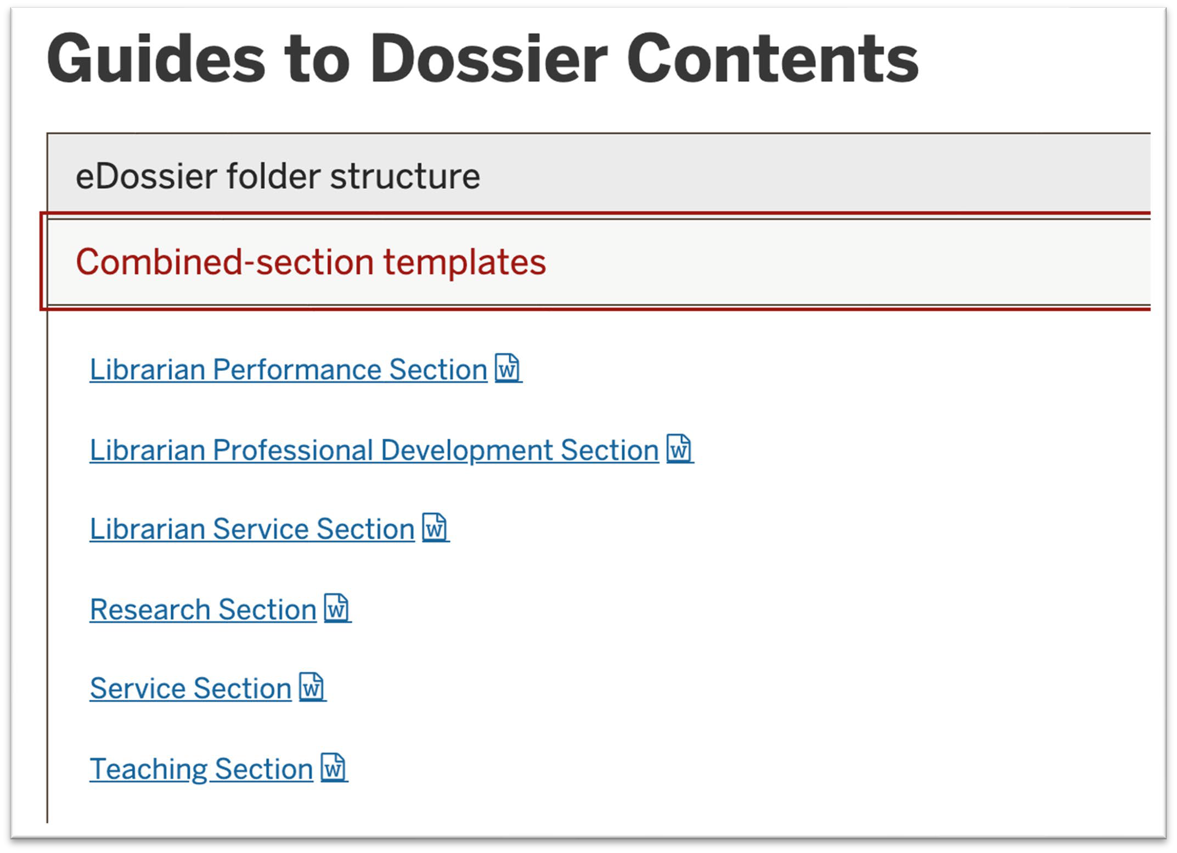
Option for Organzing Dossier folders
Use these Word templates to gather all your information into
ONE file.

Slide 41
Option for Placement in eDossier for Integrative Cases
In Balanced-Integrative cases, combine the following into two Word documents or PDFs:
Main section
  Deposited in Research for tenure track faculty
  Deposited in Teaching for clinical/lecturer faculty
  Deposited in Performance for librarians
Appendices
  Deposited in first folder for Appendices for Research for tenure track faculty
  Deposited in first folder for Appendices for Teaching for clinical/lecturer faculty
  Deposited in first folder for Appendices for Performance for librarians
Each should have a table of contents indicating the sections.

Slide 42
Typical appendix materials
Course syllabi, assignments
Copies of key articles (or, link via CV.)
Complete student evaluation reports,
peer evaluations
Letters of appreciation from students or community
You can REFER to these documents in the main section or your candidate statement. You can create internal links within e-dossier, however, no external reviewer will be able to use them.

Slide 43
Critical documentation issues

Slide 44
Co-authorship (independence)
There’s no ‘we’ in promotion. Or tenure.

Slide 45
Provide confirmatory information
Author order: your chair will explain the conventions for author order and role.
  If you are not first author but ARE ‘corresponding’ author, indicate that.
  Many readers will default to believing the first author and the last author are the only ones who are important. Explain!
Include statements from co-authors about your contribution.
  Send simple emails: you did this, I did that, right? Preserve the response.
  Save any journal forms which capture responsibility.
This is especially important when you often collaborate with the same people /and/or/ those same people are your dissertation chair or senior members of your department.

Slide 46
More on collaborator confirmation
All tenure cases require scholarly independence: a unique and confirmed role in the production of scholarship.
‘Unique’ means, the scholarly product would not be the way it is without YOU participating (‘hire a consultant’ vs. ‘work with YOU.’)
‘Confirmed:’ Some or all of these:
Lead author responsibility.
Differing co-authors; not always your dissertation chair or senior members of your department.
Clear articulation in the candidate statement of what YOU contributed.
Emails from at least one collaborator for at least your “3-5 most significant” works of scholarship. “I did this, you did that, right?”

Slide 47
Teaching evaluations
All faculty with teaching responsibilities (=all except research scientists) must have:
Student (learner) evaluations Peer evaluations
If you are not yet full rank, don’t forget to keep going on evaluations.

Slide 48
Peer evaluations
“Peer” means “fellow faculty member.”
They do not need to be of a higher rank or of your same type; experienced senior lecturers or teaching professors would be very good.
CTL staff are also okay but only in addition to fellow faculty.
For teaching-related integrative cases: one per type of teaching per year.
For satisfactory-in-teaching: at least two. Best: one per year.

Slide 49

Hi, I’m a professor
But you don’t look like one.
(Image from google: ‘professor image’)

Slide 50
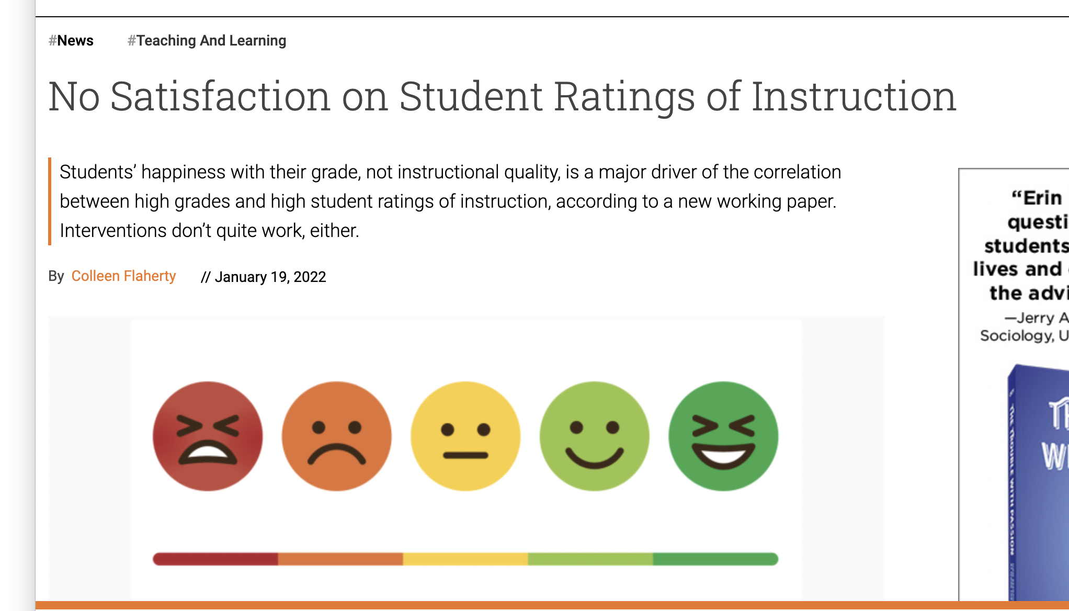
Student evaluations
1/19/2022 article
Extensive research shows some faculty get higher scores than they deserve and others lower, when they don’t conform to student expectations.
NEITHER a high NOR a low score is sufficient evidence of teaching ability or impact.

Slide 51
Student evaluations
Teaching gateway courses, hard courses, specialized courses, unusual topics, new methods….
the main point is:
how do YOU monitor student success and continually improve as a teacher?
Gives students an anonymous way to make comments without fear of retaliation.
  Student evaluations are the ONLY anonymous material allowed in faculty records.
Individual items (questions), and individual comments, can be used by faculty to improve their teaching.
For promotion and tenure the most important point is to discuss how YOU use input from:
  Student evaluations
  Peer evaluations
  Student work/accomplishments
  To improve your teaching.

Slide 52
Documenting Scholarly Impact

Slide 53
Evidence of quality and impact of activities
Quality indicators include but are not limited to traditional metrics such as publication and consequent citations; receipt of internal or external funding; competitive or invited presentations.
Qualitative and quantitative input from local constituencies is an essential element of demonstrating impact.
Other evidence can include program evaluation reporting generated for funders and other organizations; awards; descriptions of policy or other changes made as a result of efforts.

Slide 54
The dissemination requirement
”Dissemination” varies by type of activity and by discipline: conference presentations, websites/resources, books, articles.
“Peer-reviewed” means, not just the participants in an activity, or recipients of services, but scholarly/academic peers.
Candidates must have at least some peer-reviewed dissemination but it need not be binned

Slide 55
For tenure-track faculty
Type of case | Dissemination Requirement
Excellence in | Teaching | Research | Service
Teaching | X | X | --
Research | -- | X | --
Service | -- | X | X
Balanced case- binned | X | X | --
Balanced- Integrative | peer-reviewed scholarship required, need not be binned
Binning: for grants, presentations, and publications, each one is designated with one “area” in teaching, research, or service.

Slide 56
Document Your Impact
For both traditional and non-traditional forms of dissemination (everything besides journal articles with citation indexes), librarians can help you make it count.
They will show you how to preserve it for future retrieval and boost citations (ScholarWorks)
They will help you document impact (Research Metrics)

Slide 57
Using eDossier

Slide 58
Polishing your dossier

Slide 59
Please Don’t
Typos (“Presentatons” “Publicatoin”)
Writing in the third person (“Dr Tchaikovsky has many publications”)
Personal information (Children: Cain (12) and Abel (10)).

Slide 60
Effectively presented
Sample Dossiers
must be logged into IU Login
Fulfills all of the technical requirements
  This shows readers that you respect the process and their time and effort
Avoids editing or typographical errors
  Errors cause your readers to slow down, to stumble and eventually to get irritated
Presents sufficient information but not too much
  Massive, undifferentiated information causes your readers to miss your main points

Slide 61



What reviewers are thinking….
Wow, you’re amazing
This is easy!
Okay, managed to cover the basics
I found what I needed
Seriously?
But no, we’re not going to fail you for that
Or maybe we are

Slide 62
Q&A

Slide 63
Rachel Applegate
Assistant Vice Chancellor for Faculty Affairs
rapplega@iupui.edu
Margie Ferguson
Senior Associate Vice Chancellor for Academic Affairs
mferguso@iupui.edu
Willie Miller
Faculty Advancement and Leadership Development Fellow
wmmiller@iupui.edu

